Slide 1


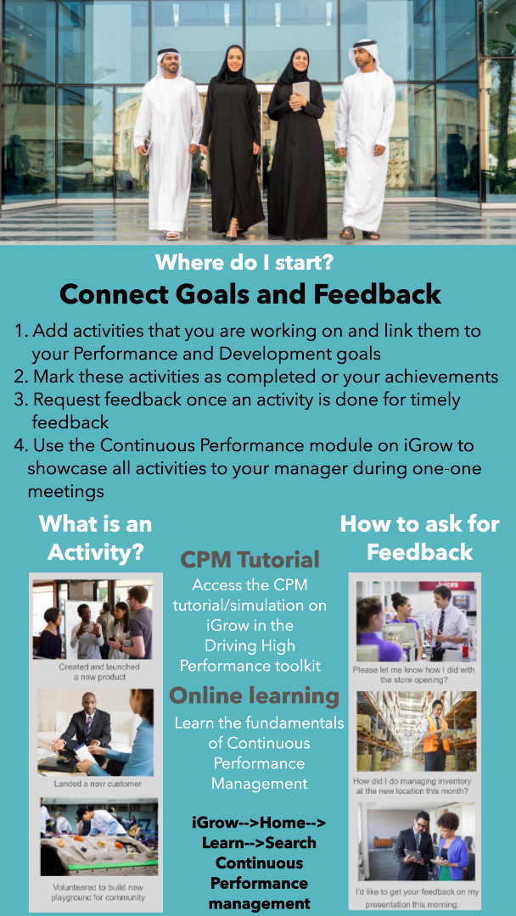
CONTINUOUS PERFORMANCE MANAGEMENT

